Slide 1
Single wavelength / channel optical communication
Modulator
Electrical signal out
λ₁
Rx
Tx
Optical fiber
Electrical signal in
The simplest optical communication scheme is single wavelength / channel communication.
The light from a single laser (VCSEL, DFB laser, etc.) is electrically-modulated and sent through a single or multimode fiber.
The light is detected at the other end of the fiber and converted back into electrical signal.

Slide 2
Single wavelength / channel optical communication
10GB/s transceiver
850nm VCSEL
Max Range ~300m
Short reach data center applications
Source: Finisar

Slide 3
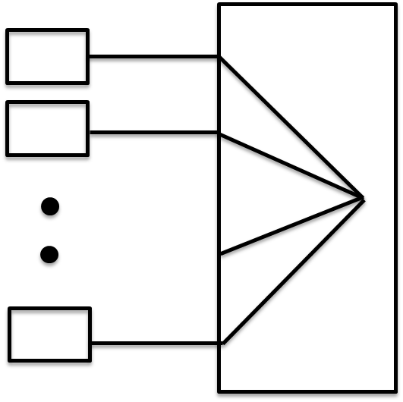
Wavelength division multiplexing (WDM)
λ₁
λ₁
Tx
Rx
λ₂
λ₂
Tx
Rx
Optical fiber
Tx
λ_{N}
λ_{N}
Rx
Optical multiplexer
Optical demultiplexer
Many wavelengths are sent down the same optical fiber
Capacity is increased by N times, N = # wavelengths

Slide 4
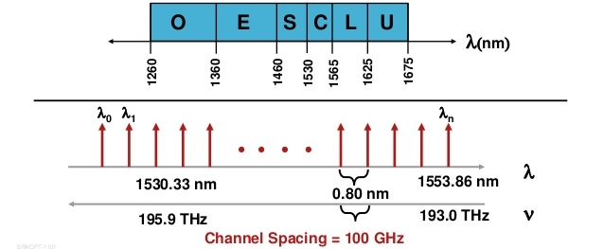
Wavelength division multiplexing (WDM)
The International Telecommunications Union (ITU) has standardized the telecom wavelengths and spacing. The C-band is commonly used for dense WDM (DWDM).
Source: Cisco

Slide 5
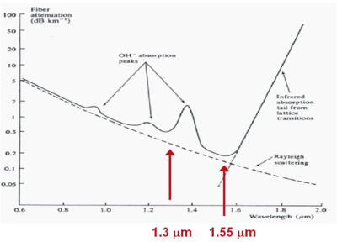
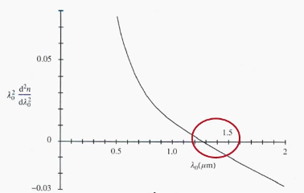
Attenuation and dispersion in silica fibers
1550 nm is minimum attenuation point
1300 nm is minimum dispersion point
Source: photonicswiki.org

Slide 6
Wavelength division multiplexing (WDM)
λ₁
λ₁
Tx
Rx
λ₂
λ₂
Tx
Rx
Optical fiber
Tx
λ_{N}
λ_{N}
Rx
Optical multiplexer
Optical demultiplexer
What is inside the box?

Slide 7
Silicon photonics
Silicon photonics has emerged recently as a new technology for photonic communication.
Pros:
Large index contrast → reduced size of optical components
Leverage existing silicon infrastructure and expertise
Photonics and electronics can coexist (in principle)
Cons:
Silicon is a “dark” material
Difficulty in coupling light
Large thermo-optic effect

Slide 8
Silicon photonics
For the next three class periods we will discuss strategies to demodulate and modulate optical signals
We will primarily focus on ring resonator based designs although by no means the only way to multiplex or demultiplex light.
First, we need to discuss one important passive optical component called the directional coupler.

Slide 9
Mode coupling between waveguides
What happens if I excite the fundamental mode of Waveguide A and place waveguide B nearby?
Light in
Waveguide A
Waveguide B

Slide 10
Mode coupling between waveguides
The mode in Waveguide A happily travels down the waveguide and does not “feel” the effect of Waveguide B since it is too far away
Light in

Slide 11
Mode coupling between waveguides
Now, what if waveguide A and waveguide B are placed right next to each other. The fundamental modes of each waveguide are coupled and will form a “supermode”.
What if we excite the supermode?
Light in
Waveguide A
Waveguide B

Slide 12
Mode coupling between waveguides
The “supermode” happily travels down the waveguide
Light in
Waveguide A
Waveguide B

Slide 13
Mode coupling between waveguides
Now, what if I excite only one waveguide and then bring both waveguides into close proximity to each other?
Light in
Waveguide A
Waveguide B

Slide 14
Mode coupling between waveguides
Energy periodically sloshes back and forth between both waveguides.
Waveguide A
Waveguide B

Slide 15
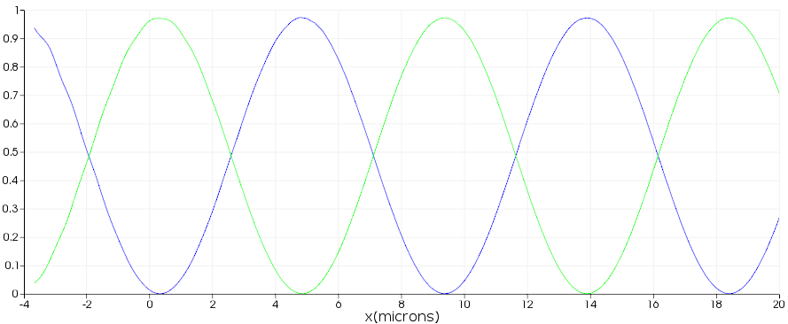
Mode coupling between waveguides
Power in Waveguide A
Power in Waveguide B

Slide 16
Mode coupling between waveguides
For $κl=\left(2n+1\right)π/2$, complete coupling of power from Waveguide A to Waveguide B occurs
For $κl=nπ$, zero coupling of power from Waveguide A to Waveguide B occurs
$κ$ is a geometry dependent coupling strength term and has units of inverse length.

Slide 17
Mode coupling: Mechanical analogy
This “sloshing” of energy back and forth between waveguides seems odd but is also observed between other coupled systems including two coupled mechanical pendulums.
Coupled Pendulum-CjJVBvDNxcE.mkv
(https://www.youtube.com/watch?v=CjJVBvDNxcE)

Slide 18
Coupled modes as a quantum two-level system
H₀ is the energy in an individual mode
H₁ is the overlap energy of the two modes
(“supermodes”)
E-fields in phase
Constructive
interference
E-fields out of phase
Destructive
interference
Notes:
H=\left( \begin{matrix} H_0 && H_1 \\ H_1 && H_0\end{matrix}\right)
\Psi_1 = \left(\begin{matrix} 1 \\ 1\end{matrix}\right),
\Psi_2 = \left(\begin{matrix} 1 \\ -1\end{matrix}\right) \\ \\
E_1=H_0+H_1, \; E_2=H_0-H_1

Slide 19
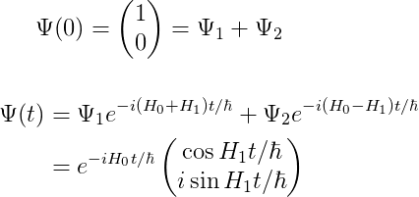
Coupled modes as a quantum two-level system
H₀ is the energy in an individual mode
H₁ is the overlap energy of the two modes
Start in one waveguide
(“supermodes”)
E-fields in phase
Constructive
interference
E-fields out of phase
Destructive
interference
For more rigorous E&M treatment
See Chuang 8.2
Oscillation between the two waveguides
Notes:
H=\left( \begin{matrix} H_0 && H_1 \\ H_1 && H_0\end{matrix}\right)
\Psi_1 = \left(\begin{matrix} 1 \\ 1\end{matrix}\right),
\Psi_2 = \left(\begin{matrix} 1 \\ -1\end{matrix}\right) \\ \\
E_1=H_0+H_1, \; E_2=H_0-H_1
\Psi(0)=\left(\begin{matrix} 1 \\ 0 \end{matrix}\right) = \Psi_1+\Psi_2 \\ \\
\begin{align*}
\Psi(t)&=\Psi_1e^{-i(H_0+H_1)t/\hbar}+\Psi_2 e^{-i(H_0-H_1)t/\hbar}\\
&=e^{-iH_0t/\hbar}\left(\begin{matrix} \cos{H_1 t/\hbar} \\ i \sin{H_1 t/\hbar}\end{matrix}\right)
\end{align*}

Slide 20
Ring resonator
Light traveling down waveguide can couple to resonant mode within the ring resonator
Resonance wavelength occurs when light accumulates a phase shift of $2π$ when traveling around the ring:
Waveguide
$$a_{1}$$
$$t$$
$$b_{1}$$
$κ$*
$$κ$$
$$a_{2}$$
$$b_{2}$$
$t$*
Ring Resonator

Slide 21
Ring resonator
Waveguide
$$a_{1}$$
$$t$$
$$b_{1}$$
$κ$*
$$κ$$
$$a_{2}$$
$$b_{2}$$
$t$*
Ring Resonator
Power conservation:
$$t^{∗}t−κ^{∗}κ=1$$
U
Proof:

Slide 22
Ring resonator
Waveguide
$$a_{1}$$
$$t$$
$$b_{1}$$
$κ$*
$$κ$$
$$a_{2}$$
$$b_{2}$$
$t$*
Ring Resonator
Power conservation:
$$t^{∗}t−κ^{∗}κ=1$$
Circulation condition:
$$a_{2}=b_{2}e^{iθ}e^{−\frac{α}{2}L}$$
Define
$$a=e^{−\frac{α}{2}L}$$
(loss in ring)
$θ:$ phase change in ring
=>
$$\frac{b_{1}}{a_{1}}=\frac{t−ae^{iθ}}{1−ate^{iθ}}$$

Slide 23
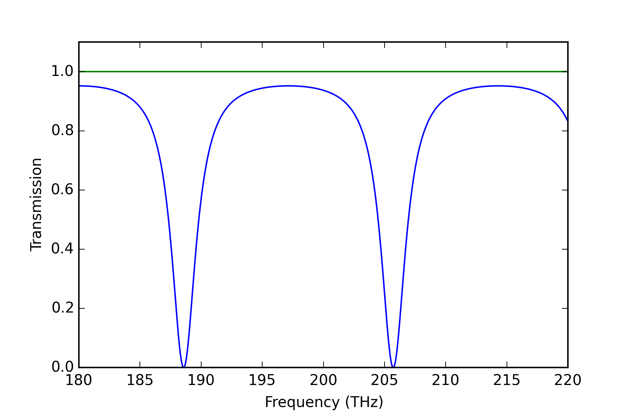
Power transmission
$$a=1 \\ (no waveguide loss)$$
$$T={\left|\frac{t−ae^{jθ}}{1−ate^{jθ}}\right|}^{2}$$
$$θ:phase change in \\ ring$$
$$a=\left|t\right| \\ (critical coupling)$$
$$a=e^{−αL/2} \\ \left(loss in ring\right)$$
$$L:ring length$$

Slide 24
Ring resonator example
Hewlett Packard Enterprise - Silicon Microring Resonators-jdAYo5bM01k.mp4
(https://www.youtube.com/watch?v=jdAYo5bM01k)

Slide 25
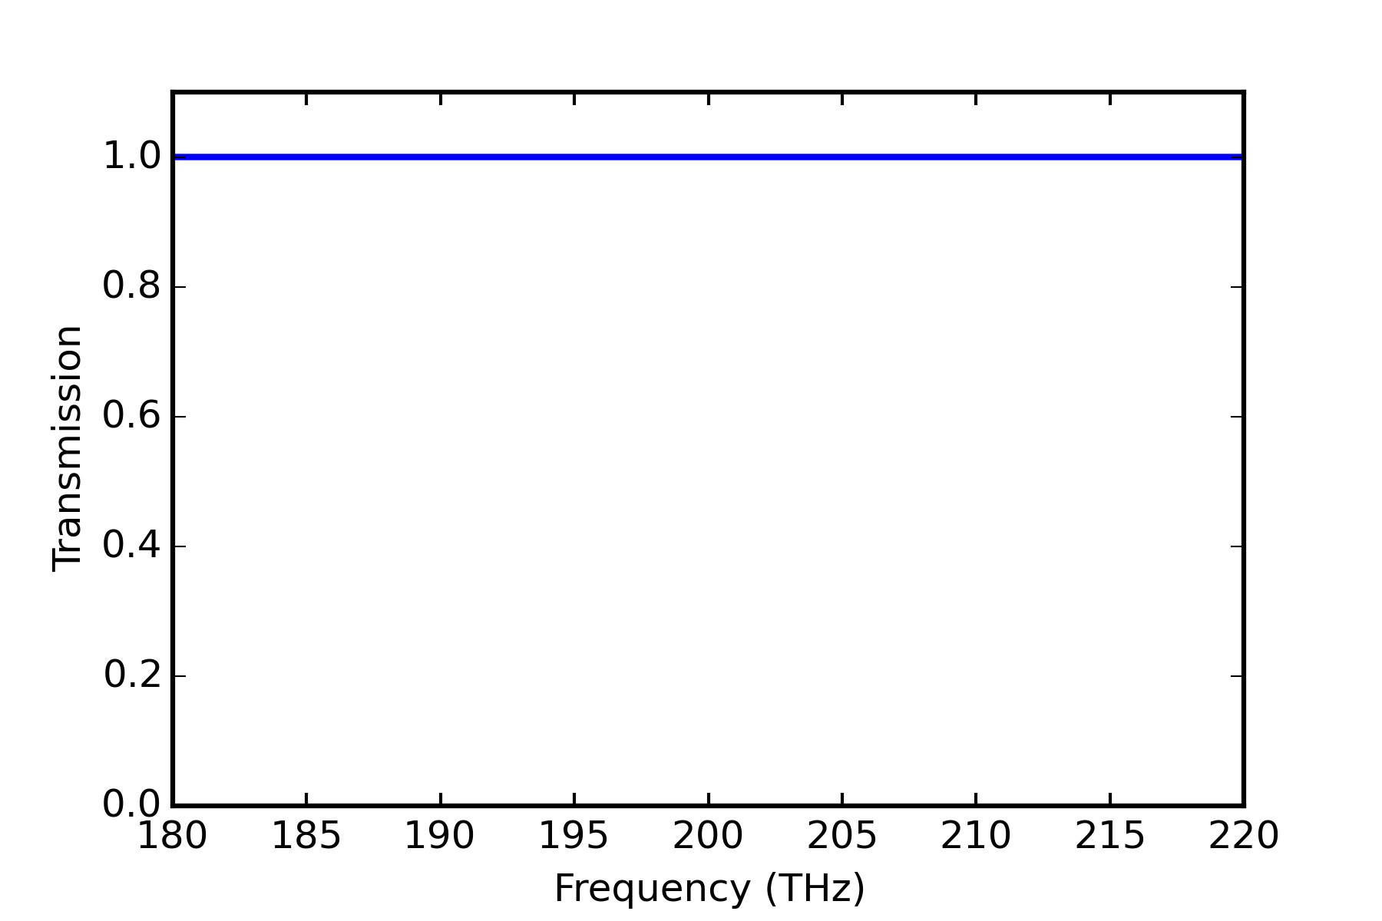
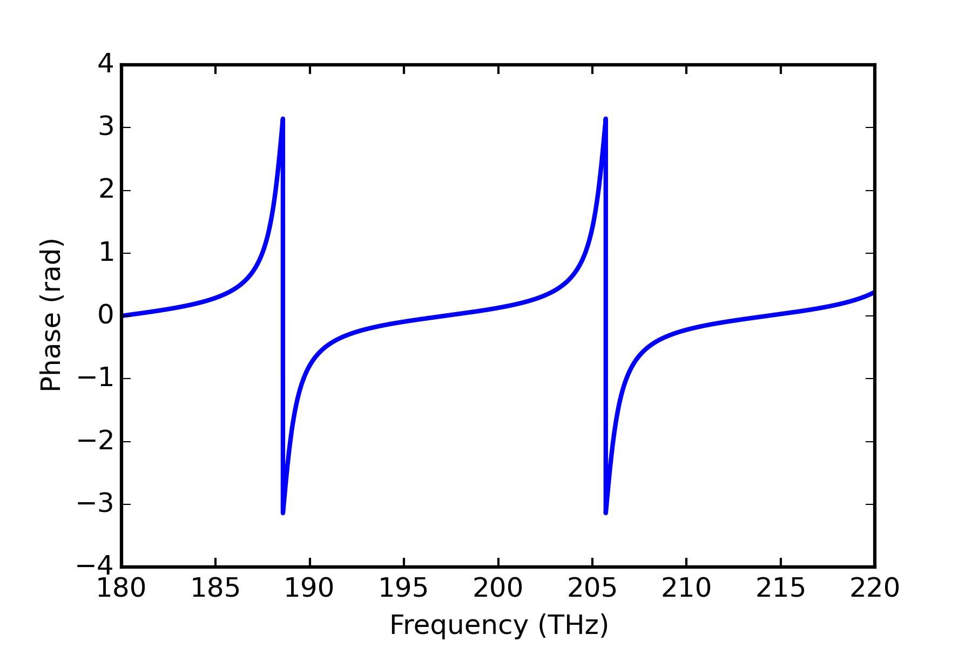
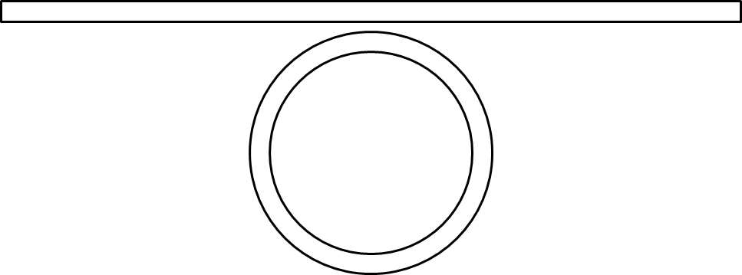
Ring resonator all-pass filter
Ring resonator with low waveguide loss ($a\sim 1)$ can be used an all-pass filter with $π$ phase delay
What use do we have for this? Large change in phase at resonance introduces group delay → optical buffer, dispersion compensation, delay for Mach-Zehnder interferometer.

Slide 26
Ring resonator all-pass filter
Mach-Zehnder interferometer (MZI)
Mach-Zehnder interferometer (MZI)
w/ ring resonator delay stage
Light in
$$τ$$
Light out
Light in
Light out
Destructive interference at output if delay stage introduces $π$ phase shift.
Traditional delay stage incorporates non-linear medium which will have refractive index change with applied voltage. Delay stage length may need to be
millimeters long to get $π$ phase shift.
Compact delay stage

Slide 27
Add/Drop ring resonator filter
Ring resonator shown on previous page can be used as a notch filter however we need to precisely match the transmission coefficient to the loss coefficient in the ring which in practice is not easy.
Adding another waveguide bus allows you to couple the light out of the ring thus forming a bandpass filter.
Waveguide
$$t$$
Input
$$κ$$
Through
Ring Resonator
$$κ$$
Drop

Slide 28
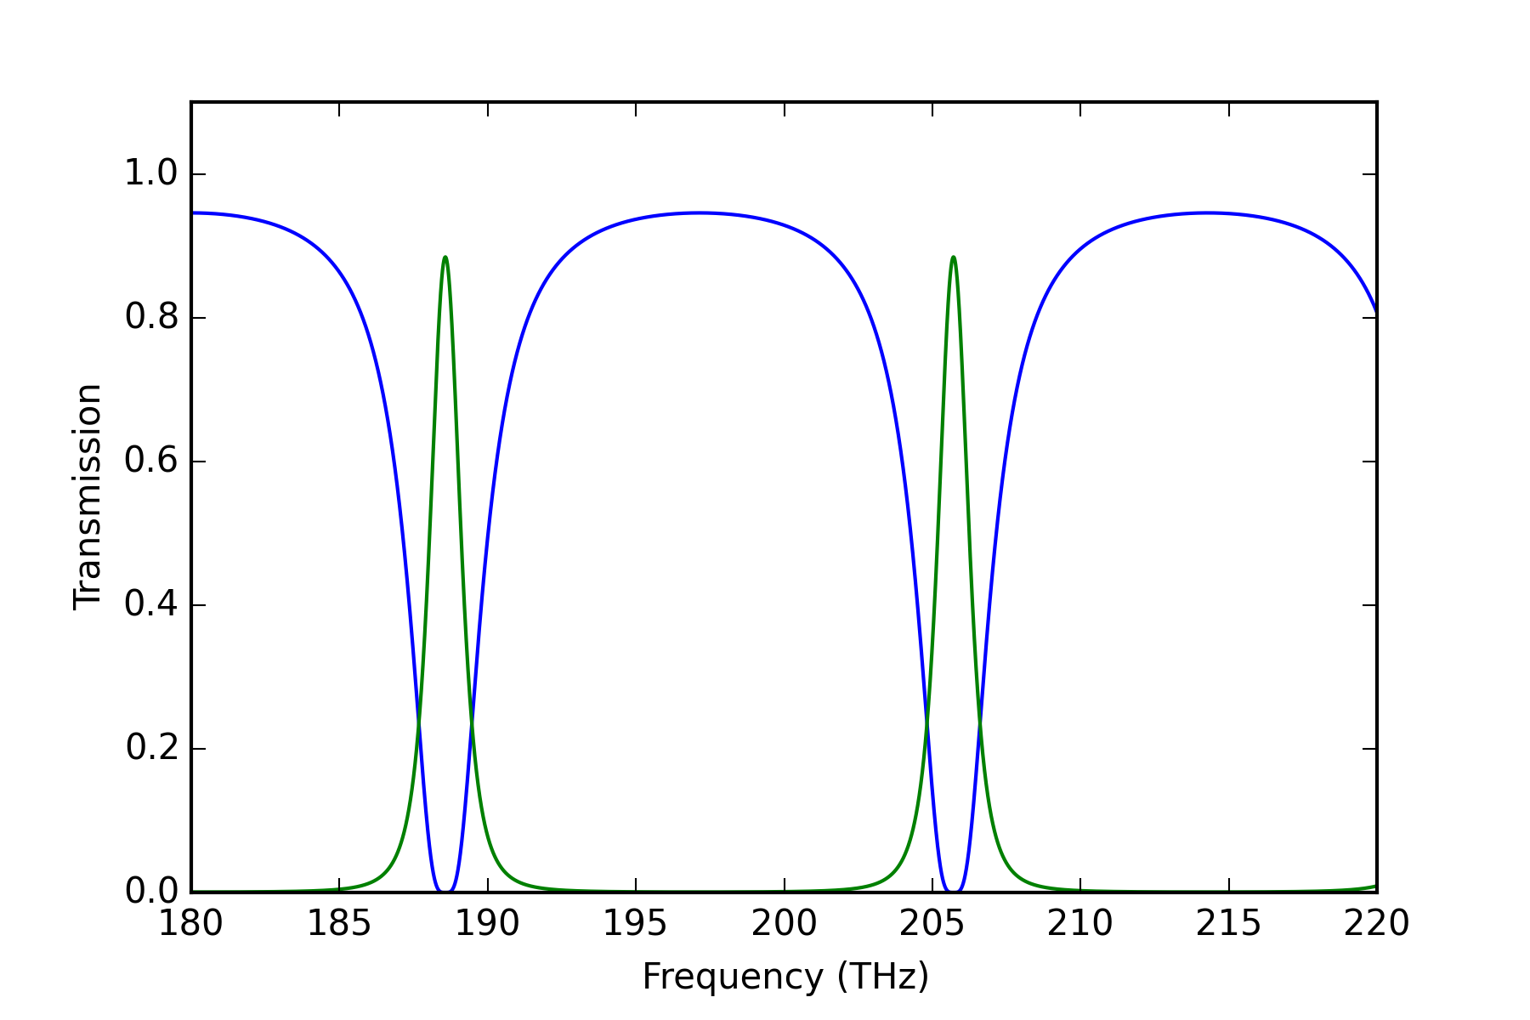
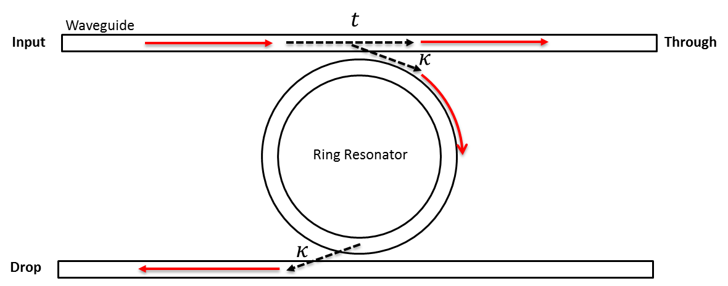
Add/Drop ring resonator filter
drop
through

Slide 29
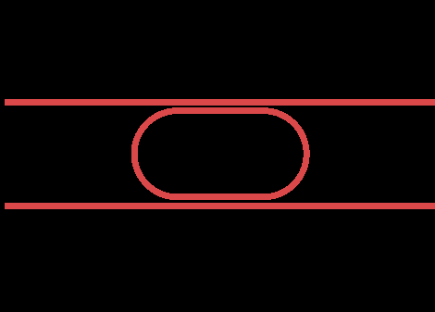
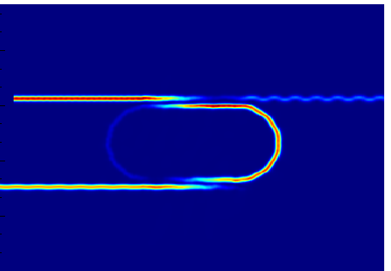
Add/Drop ring resonator filter
Input
Through
Input
Through
Drop
Drop

Slide 30
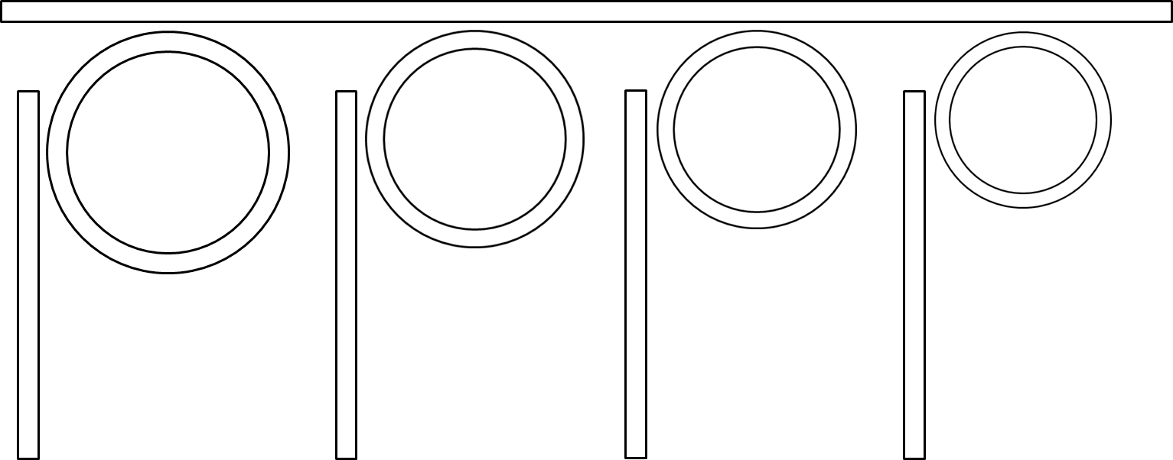
WDM demultiplexing
Basic implementation
$$λ_{1},λ_{2},λ_{3},λ_{4}$$
(in)
$$λ_{4}$$
$$λ_{3}$$
$$λ_{2}$$
$$λ_{1}$$
Detector
Detector
Detector
Detector

Slide 31
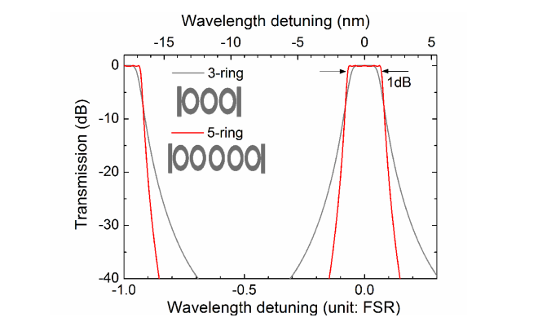
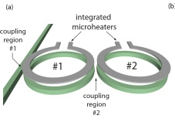
Comments on ring resonators
Higher order filters can be constructed by adding several rings in series.
Resonant frequency of ring resonator is very sensitive to process variation (variation in effective index) and temperature.
Practical ring resonators for use in a real-world environment need integrated temperature control to stabilize and adjust resonance frequency.
Optics Express Vol. 23, Issue 16, pp. 21527-21540 (2015)

Slide 32
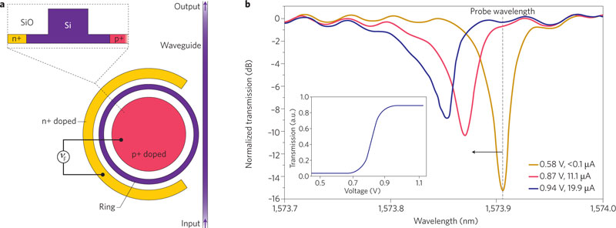
Modulation with ring resonators
Resonance frequency sensitivity to effective index can be exploited for modulation of light
The index of refraction of silicon can be modified by injecting (or removing) free carriers by applied bias
Nature 435, 325-327 (19 May 2005)

Slide 33
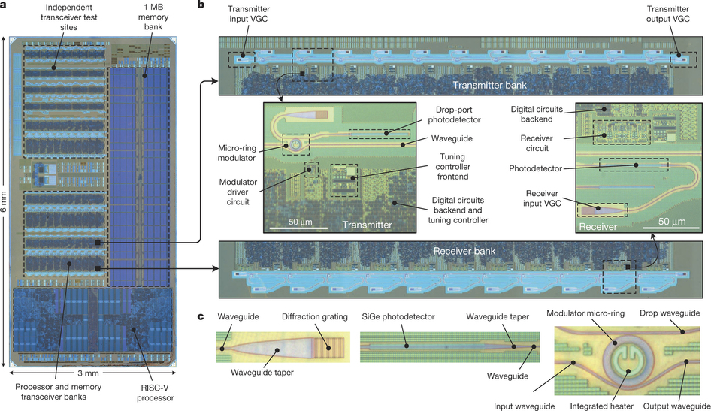
Modulation with ring resonators
Nature 528, 534–538 (24 December 2015)

Slide 34
Next week
We will discuss modulation with ring resonators and begin designing a modulator based on change in refractive index of silicon with applied bias.
Please download and install Lumerical DEVICE (device simulator) if you have not already done so.

